Slide 1


Slide 2

CONTENTS
Project Overview
Dataset
Q&A
key findings

Slide 3
1. Project Overview
The CORONA VIRUS pandemic has had a significant impact on public health and has created an urgent need for data-driven insights to understand the spread of the virus.
In this project, I analyzed a COVID-19 dataset using SQL and data analysis skills to uncover valuable insights. The dataset included information such as geographic location, dates, confirmed cases, deaths, and recoveries. My analysis was guided by a set of 16 insightful questions provided in the project guidelines, aiming to extract meaningful conclusions from the data.

Slide 4
2. Dataset
Description of each column in dataset:
Province: Geographic subdivision within a country/region.
Country/Region: Geographic entity where data is recorded.
Latitude: North-south position on Earth's surface.
Longitude: East-west position on Earth's surface.
Date: Recorded date of CORONA VIRUS data.
Confirmed: Number of diagnosed CORONA VIRUS cases.
Deaths: Number of CORONA VIRUS related deaths.
Recovered: Number of recovered CORONA VIRUS cases.

Slide 5


Slide 6
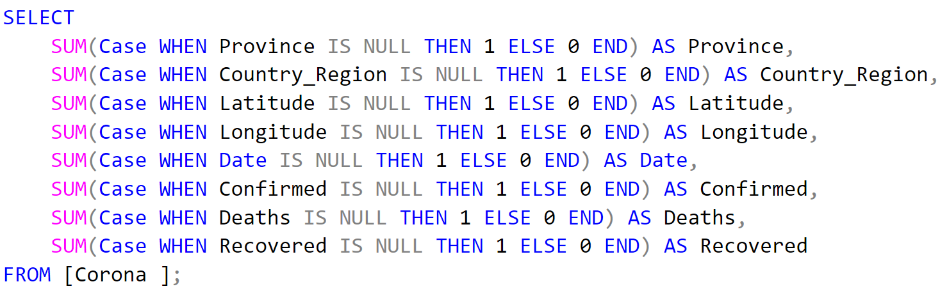
Q1. Write a code to check NULL values

Slide 7
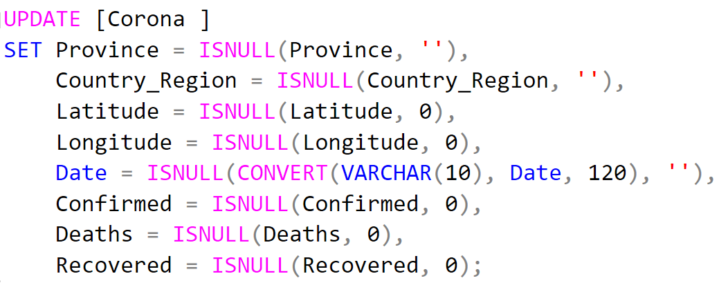
Q2. If NULL values are present, update them with zeros for all columns

Slide 8
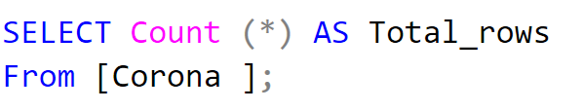

Q3. Check total number of rows

Slide 9
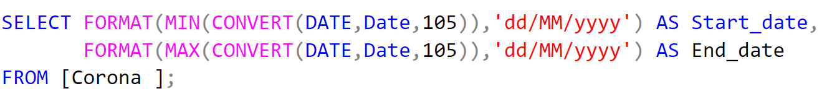

Q4. Check what is start_date and end_date

Slide 10
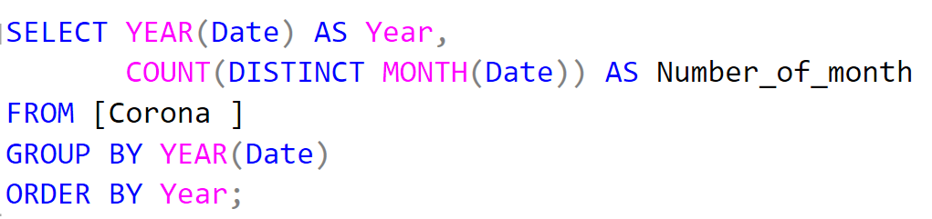
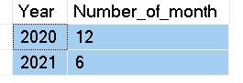
Q5. Number of month present in dataset

Slide 11
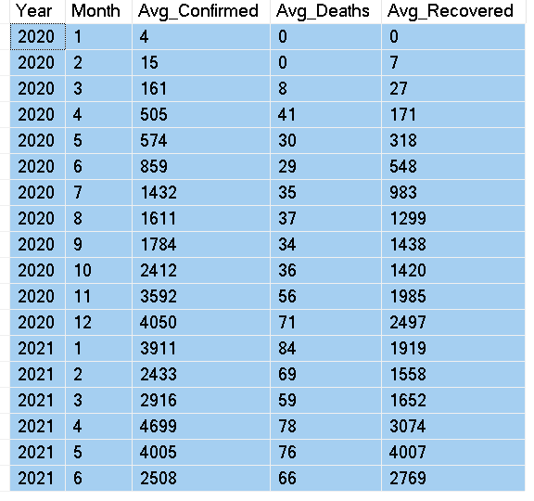
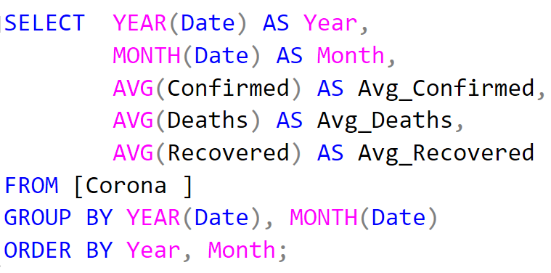
Q6. Find monthly average for confirmed, deaths, recovered

Slide 12
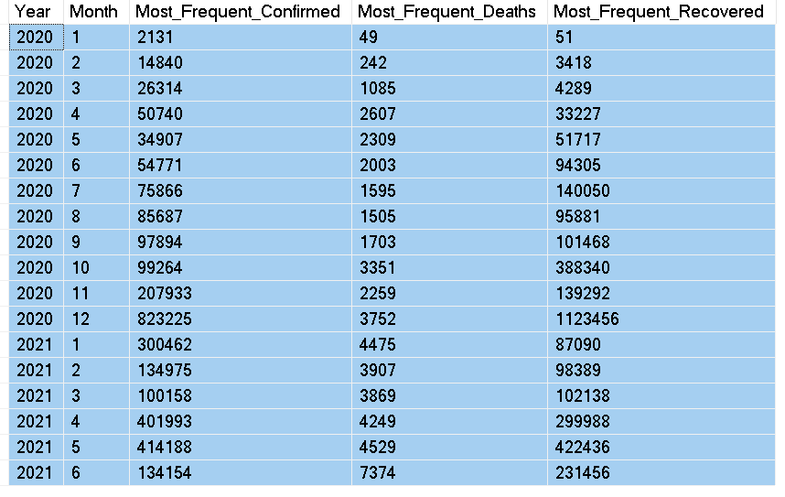
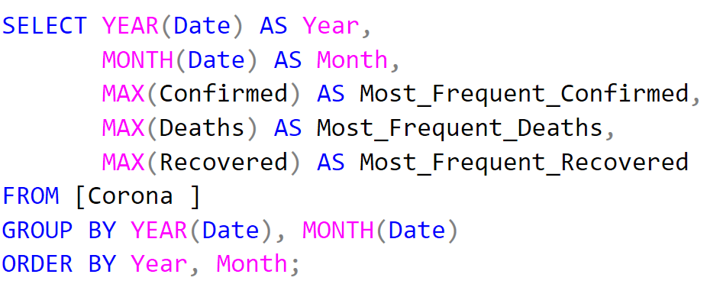
Q7. Find most frequent value for confirmed, deaths, recovered each month

Slide 13
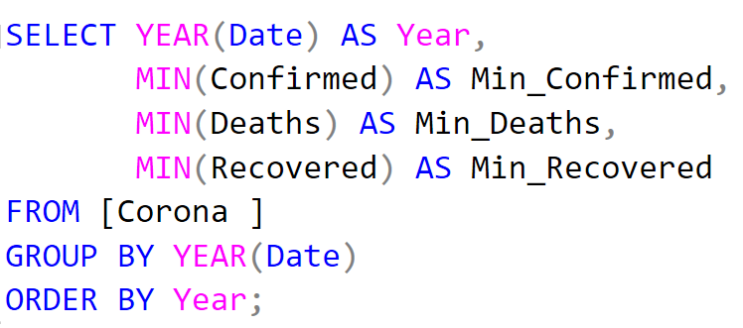

Q8. Find minimum values for confirmed, deaths, recovered per year

Slide 14
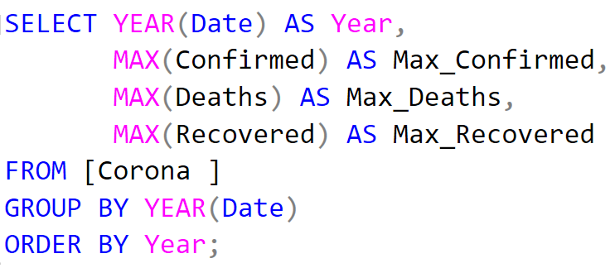
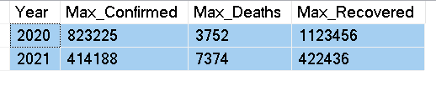
Q9. Find maximum values of confirmed, deaths, recovered per year

Slide 15
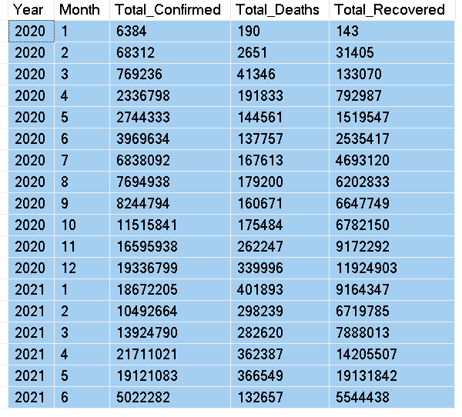
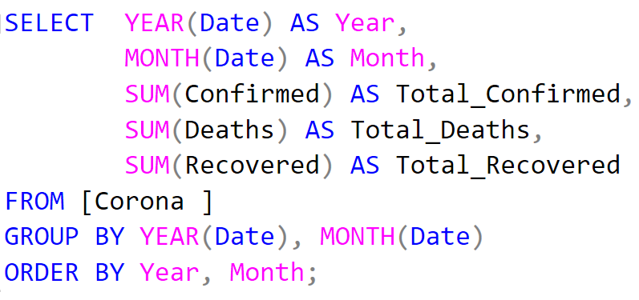
Q10. The total number of case of confirmed, deaths, recovered each month

Slide 16
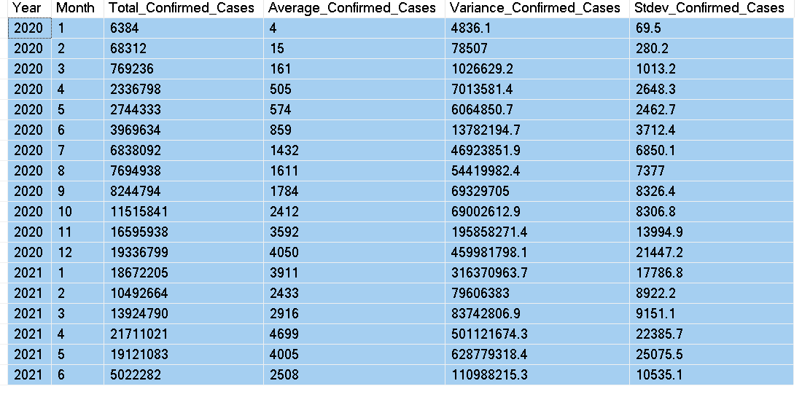
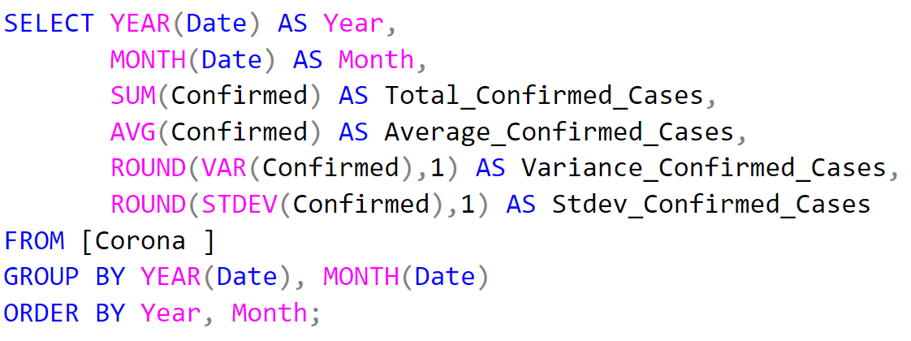
Q11. Check how corona virus spread out with respect to confirmed case (Eg.: total confirmed cases, their average, variance & STDEV )

Slide 17
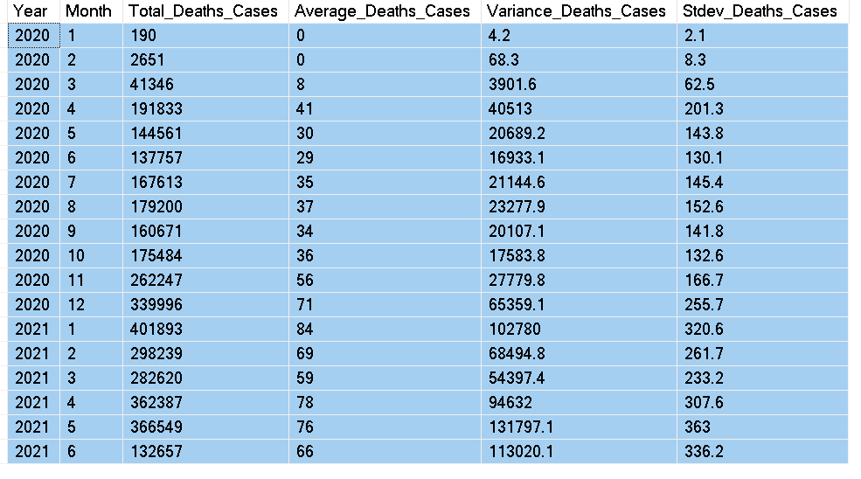
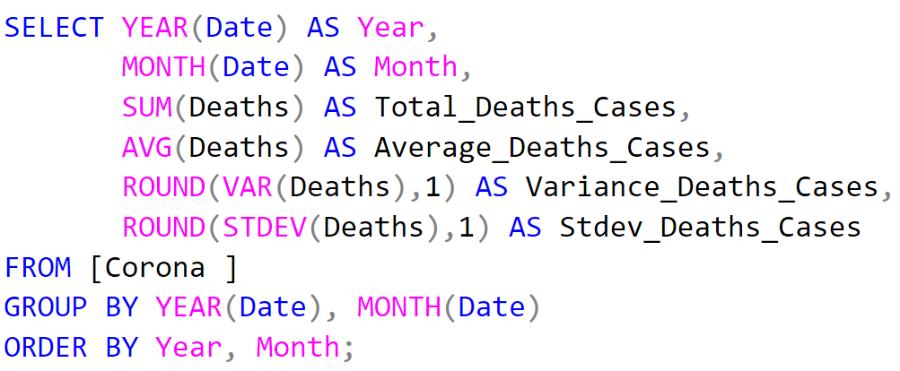
Q12. Check how corona virus spread out with respect to death case per month (Eg.: total death cases, their average, variance & STDEV )

Slide 18
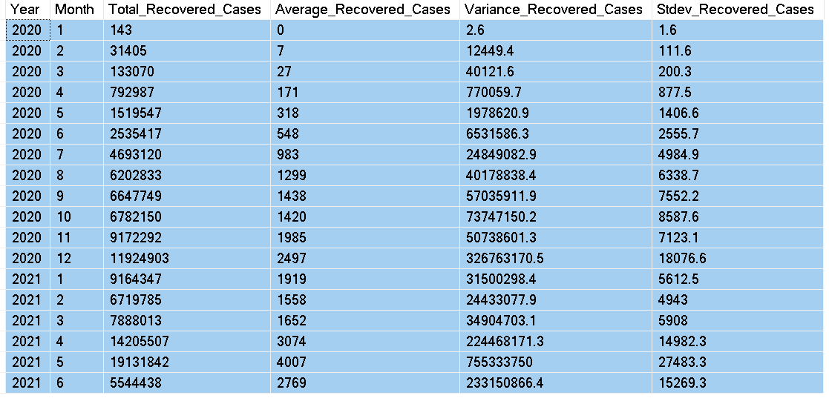
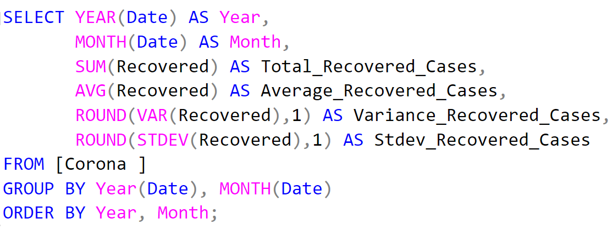
Q13. Check how corona virus spread out with respect to recovered case (Eg.: total recovered cases, their average, variance & STDEV )

Slide 19
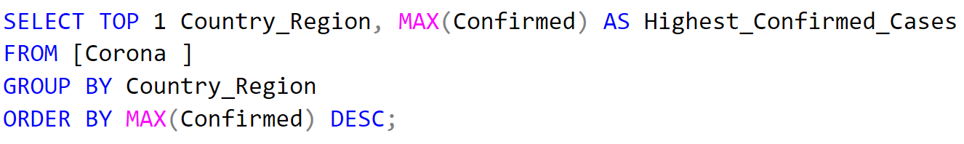

Q14. Find Country having highest number of the Confirmed case

Slide 20
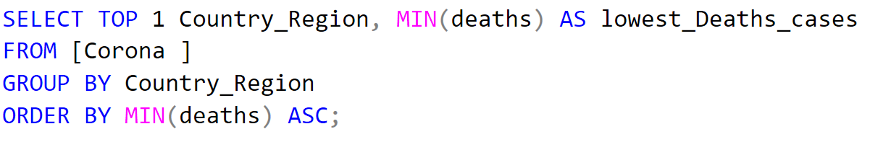

Q15. Find Country having lowest number of the death case

Slide 21
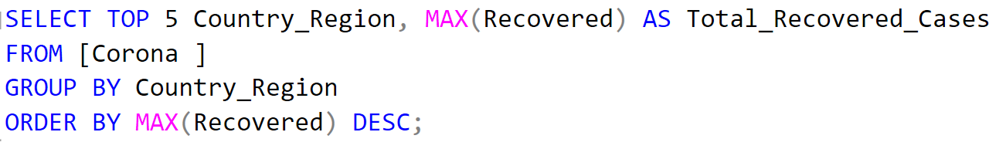
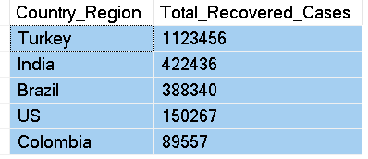
Q16. Find top 5 countries having highest recovered case

Slide 22
4. key findings
1. Data Integrity Check:
- The SQL code efficiently checks for NULL values across critical columns such as Province, Country_Region, Latitude, Longitude, Date, Confirmed, Deaths, and Recovered.
2. Data Completeness Assurance:
- NULL values are updated with appropriate defaults (zeros for numerical fields and empty strings for textual fields), ensuring data completeness and accuracy for analysis.
3. Dataset Overview:
- The total number of rows in the dataset provides a quick overview of its size and scale, aiding in understanding the scope of analysis and resource allocation.

Slide 23
4. Temporal Analysis:
- Start_date and End_date provide insight into the temporal scope of the dataset, crucial for understanding the timeframe of the analysis.
5. Temporal Distribution:
- The number of months present in the dataset and the monthly average for confirmed cases, deaths, and recoveries offer a temporal perspective, highlighting trends and patterns over time.
6. Monthly Averages:
- The monthly average for confirmed cases, deaths, and recoveries provides insight into the disease's progression and its impact over time.
7. Most Frequent Values:
- Identifying the most frequent values for confirmed cases, deaths, and recoveries each month aids in understanding recurring patterns and potential outliers.

Slide 24
8. Yearly Minimums:
- Determining the minimum values for confirmed cases, deaths, and recoveries per year helps in identifying the least affected periods.
9. Yearly Maximums:
- Identifying the maximum values of confirmed cases, deaths, and recoveries per year highlights the peak periods of the pandemic's impact.
10. Total Cases by Month:
- The total number of confirmed cases, deaths, and recoveries each month provides a detailed breakdown of the disease's spread over time.
11. Spread Analysis:
- Analyzing the spread of the virus with respect to confirmed cases, including total cases, average, variance, and standard deviation, offers insights into its progression and variability.

Slide 25
12. Mortality Analysis:
- Investigating the virus's impact in terms of death cases per month, including total cases, average, variance, and standard deviation, sheds light on its severity and variability over time.
13. Recovery Analysis:
- Assessing the virus's impact in terms of recovered cases, including total cases, average, variance, and standard deviation, provides insights into recovery trends and effectiveness of interventions.
14. Country with Highest Confirmed Cases:
- Identifying the country with the highest number of confirmed cases offers insights into the regions most affected by the pandemic.

Slide 26
15. Country with Lowest Death Cases:
- Identifying the country with the lowest number of death cases highlights regions where the impact of the virus has been relatively less severe.
16. Top Countries with Highest Recovery Cases:
- Identifying the top countries with the highest number of recovered cases showcases regions where recovery efforts have been particularly effective.
These findings collectively provide a comprehensive understanding of the dataset, its integrity, completeness, temporal distribution, geographical patterns, and impact metrics, aiding in informed decision-making and policy formulation.

Slide 27

At the end of the project, I would like to extend my sincere gratitude to Mentorness for providing me with the opportunity to embark this virtual internship. I am grateful for the guidance, support, and valuable learning experiences I have gained throughout this project, particularly in enhancing my SQL skills.

